Slide 1


Final Year Project Proposal
SpotCancerAI
Smart Skin Cancer Detection System
Supervised By: Mr Hafiz Haseeb(Junior Lecturer)

Slide 2
Project Team
Hassan Dastagir(40124)
Ali Sher Khan(39917)
Muhammad Usman(24761)

Slide 3
Table of Content
Introduction and Background
Literature Review and Summary Table
Gap Analysis
Market Survey
Opportunity And Stakeholders
Problem Statement
Proposed Solution & Methodology
Project Scope
Work Breakdown Structure
Constraints and Limitations
Roles and Responsibilities

Slide 4
INTRODUCTION AND BACKGROUND[1/2]
This project develops an AI-based model using deep learning to automatically detect and classify skin lesions from dermoscopic images. The AI-based model aims to accurately identify skin cancer types, such as melanoma, basal cell carcinoma and squamous cell carcinoma. The goal is to improve diagnostic accuracy and efficiency, supporting early skin cancer detection and assisting healthcare professionals in medical decision-making.

Slide 5
INTRODUCTION AND BACKGROUND[2/2]
Skin cancer is a major global health concern, with early detection being crucial for effective treatment. Traditional diagnostic methods, such as visual examination by dermatologists, dermoscopy, and skin biopsies, are often time-consuming, subjective, and require expert analysis. These limitations highlight the need for artificial intelligence (AI) to provide faster, more accurate, and automated skin cancer detection, improving early diagnosis and treatment outcomes.

Slide 6
LITERATURE REVIEW & SUMMARY TABLE
References | Deep Learning techniques | Dataset | Accuracy
[1] | Applied MobileNet architecture | HAM10000 | 85%
[2] | Utilized VGG16 and Streamlit | Private collected dataset | 86%
[3] | k nearest neighbors model | Population-based Australian cohort study | 91%
[4] | federated learning system | ISIC2019 | 90%
[5] | Developed a deep learning system for differential diagnosis of 26 common skin conditions | Teledermatology | 66%
[6] | Implemented CNNs with Flask | ISIC | 90%
[7] | CNN models implemented with TensorFlow Lite | Seven classes on a combined dataset | 74.27%
[8] | EfficientNetB1 and EfficientNetB5 architectures | HAM10000 | 93%

Slide 7
Gap analysis
Limited Access to Specialists: Many patients cannot easily visit a dermatologist due to location or cost.
Delay in Diagnosis: Patients depand on doctors for checkups, leading to late detection and treatment.
Lack of Diversity: The dataset has more images of lighter skin tones, making it less effective for darker skin.

Slide 8
Market Survey
Application | Technique | Test Set | Remarks
SkinVision App | Conditional generative adversarial neural network (segmentation) and SVM (classification) | 1 malignant melanoma, 41 clinically suspicious lesionsª | Only 1 malignant melanoma was Found
SpotMole | Image processing techniques, ABCDE rule | 1 malignant melanoma, 41 clinically suspicious lesionsª | Only 1 malignant melanoma was Found
Dr Mole | Algorithm based on the ABCDE rule | 1 malignant melanoma, 41 clinically suspicious lesionsª | Only 1 malignant melanoma was Found
Lubax | Content-based image retrieval, k-nearest neighbor | 208 lesions with melanoma^{d} | Algorithm tested only on malignant melanoma (large lesions only)

Slide 9
Opportunity and Stakeholders[1/2]
Opportunity:
We heard about a patient who ignored a small skin spot, thinking it was harmless, but later it was diagnosed as late-stage skin cancer. Many people delay checkups due to lack of awareness, high costs, or limited access to doctors. Existing AI models are also hard to use and inaccurate for darker skin. This inspired us to create a fast, simple, and accessible AI tool for early skin cancer detection, helping people get diagnosed quickly and accurately.

Slide 10
Opportunity and Stakeholders[2/2]
Stakeholders:
Dermatologists and Healthcare Professionals: To support accurate and efficient skin lesion diagnosis.
Patients: For initial screening and monitoring of skin lesions.
Medical Institutions: Hospitals and clinics integrating AI tools for dermatology.
Researchers: Involved in AI and skin cancer studies.

Slide 11
PROBLEM STATEMENT
Skin cancer is one of the most common and potentially fatal cancers worldwide. Early and accurate detection significantly improves survival rates, but traditional diagnostic methods are often time-consuming, subjective, and reliant on specialist expertise. The growing incidence of skin cancer, coupled with a shortage of dermatologists, leads to delayed diagnoses and limited accessibility to expert care, especially in underserved regions. Existing automated detection models struggle with accuracy and may be less effective for diverse skin tones. Therefore, there is a critical need for an AI-powered, accessible, and accurate skin cancer detection system to aid early diagnosis and improve healthcare outcomes.

Slide 12
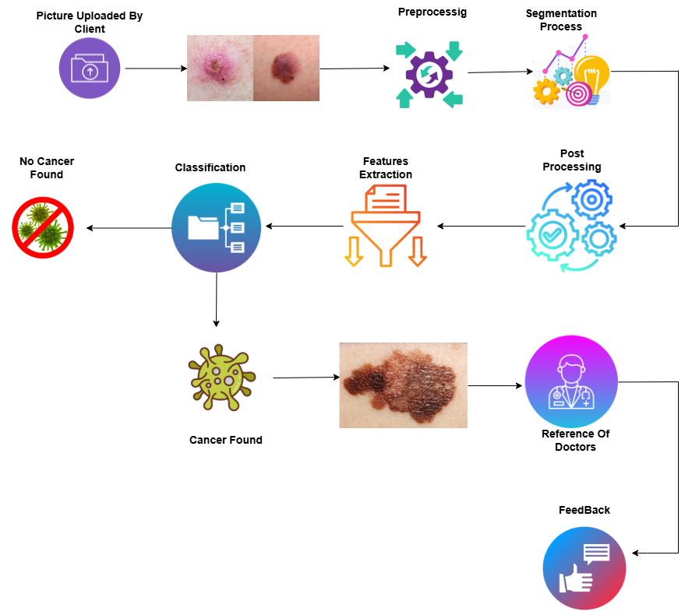
Proposed Solution and Methodology

Slide 13
PROJECT SCOPE
Key Features:
AI-Based Skin Cancer Detection: Uses deep learning to classify skin lesions.
Fast & Accurate Results: Provides quick analysis to support medical decisions.
User-Friendly Interface: Simple and easy-to-use system for both doctors and patients.
Data Security & Privacy: Ensures patient information is kept safe.
Mobile & Web Compatibility: Can be used on smartphones and computers.

Slide 14
Work Breakdown Structure
Project Planning & Research
Dataset Preprocessing
AI Model Development
User Interface & System
Development
Testing & Validation
Deployment & Integration
Maintenance and documentation

Slide 15
Constraints And Limitations
Constraints:
Model Complexity
Privacy Regulations
Real-World Validation
Limitations:
Dataset Dependency
Model Bias
Supplementary Tool
Image Sensitivity
Limited Scope
Generalization Issues

Slide 16
Roles And Responsibility
Hassan Dastagir:
Model Training
BackEnd
Documentation
Ali Sher Khan:
Model Training
Front End Designing & Development
M Usman:
Model Training
Documentation

Slide 17
References
[1] P. Pathak, Y. Punetha, Kratika, Identification of skin diseases using convolutional neural network, in: Soft Computing: Theories and Applications: Proceedings of SoCTA 2020, 2, Springer, 2021, pp. 171–180, https://doi.org/10.1007/978-981- 16-1696-9_16
[2] V. R. Pai, S. G. Pai, P. Suhasi, and P. Rekha, “Identification and classification of skin diseases using deep learning techniques,” 2023 , 10.21203/rs.3.rs-2628782/v1
[3] T.-Y. Yang, T.-W. Chien, F.-J. Lai, et al., Web-based skin cancer assessment and classification using machine learning and mobile computerized adaptive testing in a rasch model: development study, JMIR. Med. Inform. 10 (3) (2022) e33006, https://doi.org/10.2196/33006

Slide 18
[4] M.A. Hashmani, S.M. Jameel, S.S.H. Rizvi, S. Shukla, An adaptive federated machine learning-based intelligent system for skin disease detection: a step toward an intelligent dermoscopy device, Appl. Sci. 11 (5) (2021) 2145, https://doi.org/
10.3390/app11052145.
[5] Y. Liu, et al., A deep learning system for differential diagnosis of skin diseases, Nat. Med. 26 (6) (2020) 900–908, https://doi.org/10.1038/s41591-020-0842-3
[6] A. Singh, S. Srinath, V. Arasu, N.K. Thomas, et al., Machine learning on web: skin lesion classification using CNN, in: 2022 International Conference on Inventive Computation Technologies (ICICT), IEEE, 2022, pp. 260–265, https://doi.org/ 10.1109/ICICT54344.2022.9850506.
[7] I. Oztel, G.Yolcu Oztel, V.H. Sahin, Deep learning-based skin diseases classification using smartphones, Adv. Intell. Syst. 5 (12) (2023) 2300211, https://doi.org/ 10.1002/aisy.202300211.
[8] Aboulmira, A., Lachgar, M., Hrimech, H., Camara, A., Elbahja, C., Elmansouri, A., & Hassini, Y. (2024). SkinHealthMate app: An AI-powered digital platform for skin disease diagnosis. Systems and Soft Computing, 6, 200166.https://doi.org/10.1016/j.sasc.2024.200166

Slide 19
Any Question & Suggestions?

Slide 20
Thank You!

